Slide 2
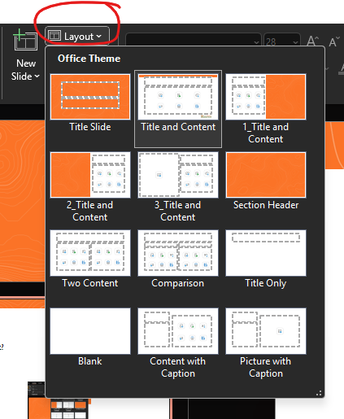
Delete this slide
How to use this PowerPoint template?
Add a new slide.
Click on the “Layout” tab then select
your desired layout.
Have questions? Reach out to
mediarelations@cobleskill.edu

